Slide 1

Freelancer System Project

Slide 2


What is The problem !?
Freelancer System
Previous Systems

Slide 3
What we suggest !
Avoid defects
Help The Freelancers

Slide 4
1.
Our Policy
Let’s start with the first setp

Slide 5
How We Can Do That !
Keep rights
Appreciation of tiredness
Strong Portfolio
You can Work , You can Buy , You Can do both .

Slide 6
I am a freelancer .
My services are available to anyone at any time.
Chris Hardwick

Slide 7
Easy to Use

Slide 8
System Analysis
Data flow diagram.
Context level .
Diagram 0 .
Database System
Entity–relationship model
Schema

Slide 9
Tools
For User
Good Browser .
E-mail .
PayPal Account.
For Admin
Good Browser .
E-mail .
Business PayPal Account .
Few knowledge About Programing Languages & SQL .
Domain & Host .
For Developers
HTML5, CSS3, JS.
XAMPP.
Photoshop & Adobe Illustrator .
PHP & MYSQL .
MS Office
Good Knowledge in Version-Control like GitHub

Slide 10
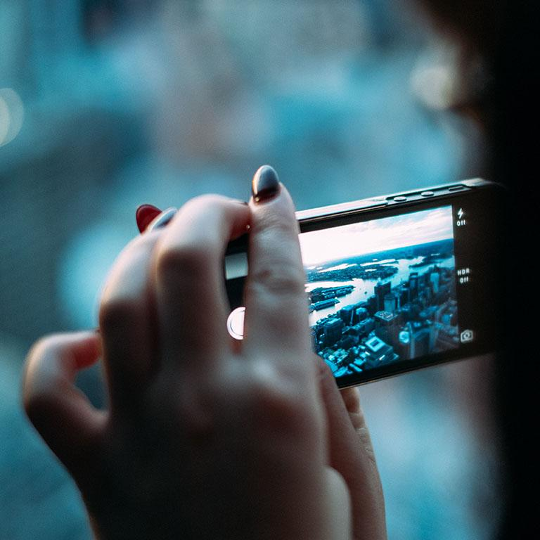


Responsive web design
In 2019 You Need Responsive website .
Use Frameworks To Help you .

Slide 11
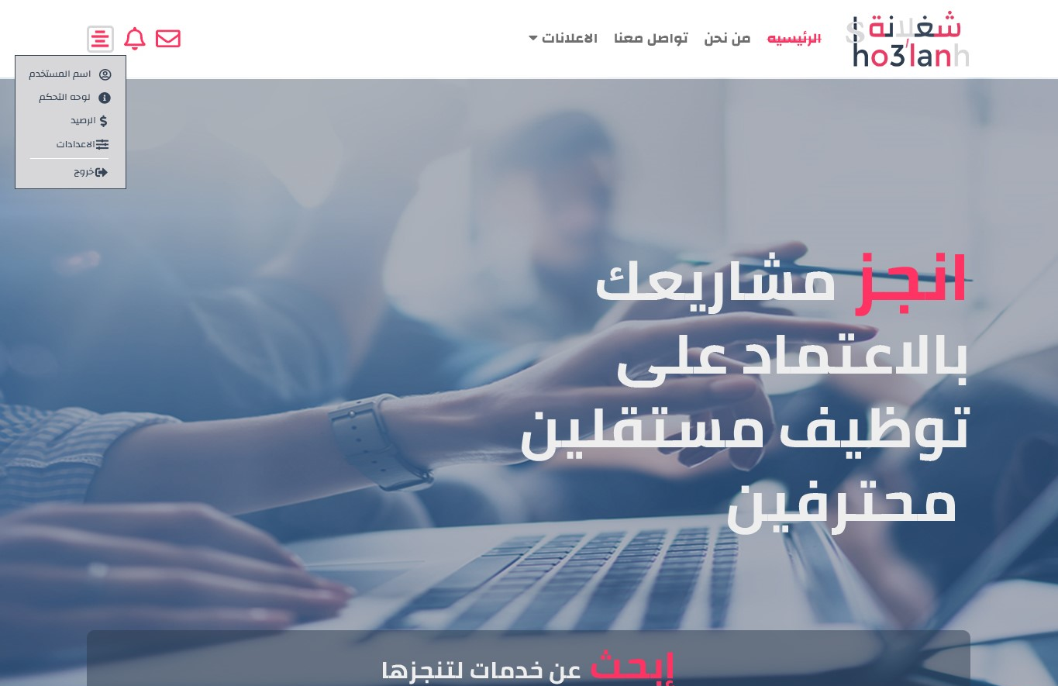
Place your screenshot here
Desktop project
Show and explain .

Slide 12

Place your screenshot here
Tablet project
Show and explain .

Slide 13
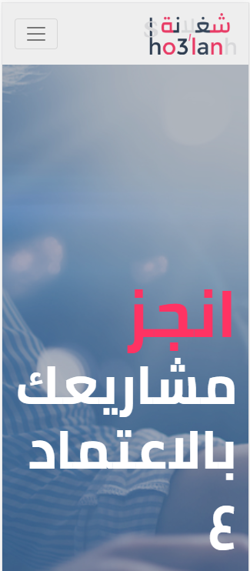
Place your screenshot here
Phone project
Show and explain .

Slide 14
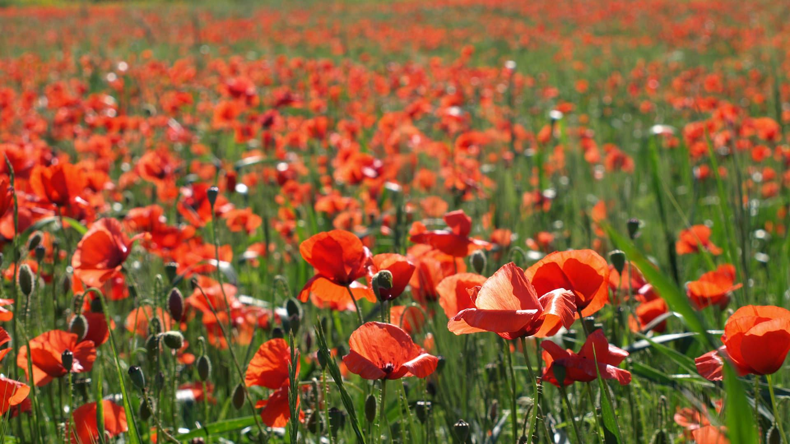
Want big impact?
Use big image.

Slide 15
Use charts to explain your ideas
White
Gray
Black

Slide 16
And tables to compare data
 | A | B | C
Yellow | 10 | 20 | 7
Blue | 30 | 15 | 10
Orange | 5 | 24 | 16

Slide 17
Maps
our office

Slide 18
89,526,124
Whoa! That’s a big number, aren’t you proud?

Slide 19
89,526,124$
185,244 users
100%
That’s a lot of money
And a lot of users
Total success!

Slide 20
Our process is easy
first
second
last

Slide 21
Let’s review some concepts
Yellow
Is the color of gold, butter and ripe lemons. In the spectrum of visible light, yellow is found between green and orange.
Blue
Is the colour of the clear sky and the deep sea. It is located between violet and green on the optical spectrum.
Red
Is the color of blood, and because of this it has historically been associated with sacrifice, danger and courage.
Yellow
Is the color of gold, butter and ripe lemons. In the spectrum of visible light, yellow is found between green and orange.
Blue
Is the colour of the clear sky and the deep sea. It is located between violet and green on the optical spectrum.
Red
Is the color of blood, and because of this it has historically been associated with sacrifice, danger and courage.

Slide 22
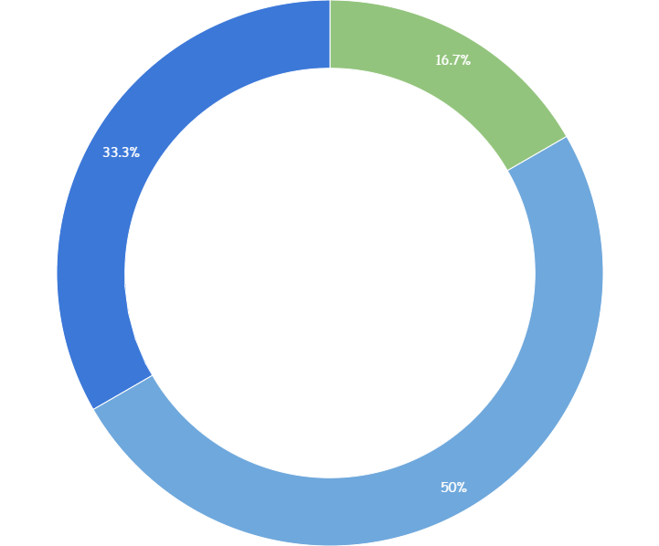
You can copy&paste graphs from Google Sheets

Slide 23
thanks!
Any questions?
You can find me at
@username
user@mailme

Slide 24
Credits
Special thanks to all the people who made and released these awesome resources for free:
Presentation template by SlidesCarnival
Photographs by Unsplash

Slide 25
Presentation design
This presentation uses the following typographies:
Titles: Walter Turncoat
Body copy: Sniglet
You can download the fonts on these pages:
https://www.fontsquirrel.com/fonts/walter-turncoat
https://www.fontsquirrel.com/fonts/sniglet
You don’t need to keep this slide in your presentation. It’s only here to serve you as a design guide if you need to create new slides or download the fonts to edit the presentation in PowerPoint®

Slide 26
SlidesCarnival icons are editable shapes.
This means that you can:
Resize them without losing quality.
Change fill color and opacity.
Isn’t that nice? :)
Examples:

Slide 27
😉
Now you can use any emoji as an icon!
And of course it resizes without losing quality and you can change the color.
How? Follow Google instructions https://twitter.com/googledocs/status/730087240156643328
✋👆👉👍👤👦👧👨👩👪💃🏃💑❤😂😉😋😒😭👶😸🐟🍒🍔💣📌📖🔨🎃🎈🎨🏈🏰🌏🔌🔑 and many more...

Slide 28
Extra graphics

